Slide 1
Online pharmacy system
By: Christensen Mario frans

Slide 2
Project Background
Over the years online shopping has been increasing ever since its introduction
Allowing individuals to purchase the goods and services they want without having to leave their homes, which may be time consuming, also they have to pay for transportation fees
However, it is not very common for us to find online pharmacies, whereas medicines and healthcare equipment should be one number one priority

Slide 3
Motivation
In recent situations, due to the COVID-19 pandemic, many pharmacies run out of stock for healthcare products, such as masks and hand sanitizers.
It’s common to see customers coming into pharmacies, only to leave 5 seconds later after being told what they’re looking for is out of stock.
So why not make an online pharmacy? So people can buy online without leaving their homes and risking of being infected, and eventually spread the virus to their relatives at home.

Slide 4
Solution & aim
Make a pharmacy prototype system for people to buy medicines online with ease.
The aim is to show users that it is also entirely possible to shop online for medicines and healthcare equipment just like other niches.
Create a user-friendly interface for the user

Slide 5
Project scope
This system will include:
Items as well as their stock count for users to see which products are available
Create a customer’s cart, and checkout system
User database to save login information (so users do not have to re-register)
Pharmacy owner account (to view customers, items sold, current stocks for specific products, adding and removing stocks from the pharmacy, and to view revenue generated)
Note: I will not be implementing this program to an actual online pharmacy; this program is only a ‘blueprint program’ to show the system and how the logic will work.

Slide 6
Data Structure
I will be using vector data structure to create the program
Vectors are known as dynamic arrays with the ability to resize itself automatically when an element is inserted or deleted
In C++, arrays cannot be modified while the program is running, vectors can be an alternative
This will be the main data structure used in this program

Slide 7
Method of implementation
I will be reading data from a text file, and use vector STL to modify these values dynamically
Other aspects that will be used in the program are aggregation, objects, classes, methods, and variables.
Aggregation is known as ‘Has a’ relationship in C++ programming.
In my program, some classes will have an aggregation relationship with another class.

Slide 8
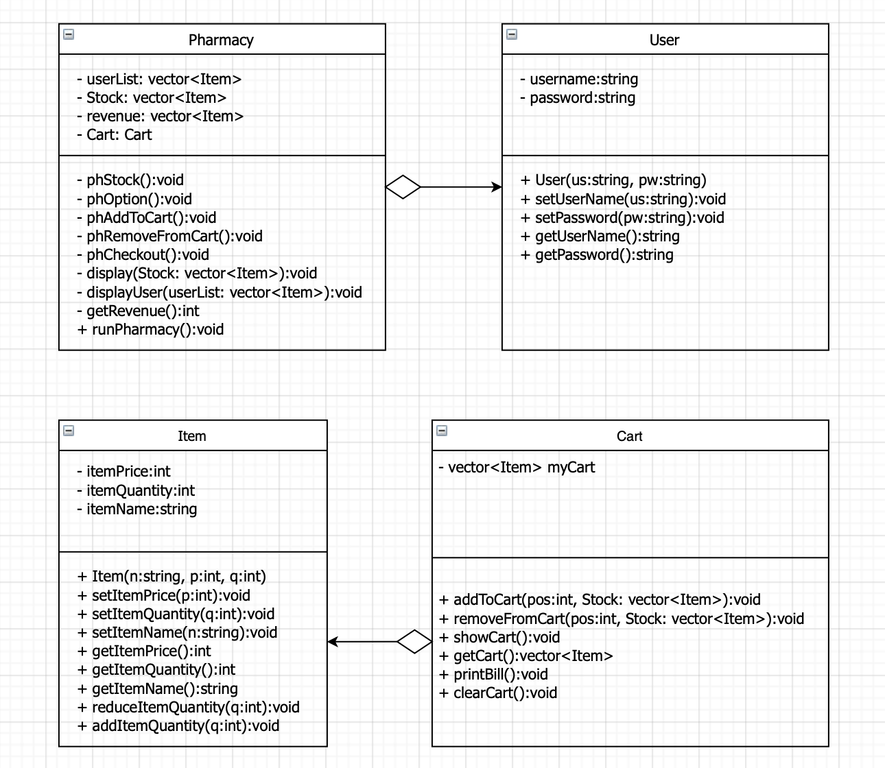
Uml diagram

Slide 9
UML Diagram
Aggregation relationship is shown using an arrow with a diamond at the back
In addition, I will be adding 3 text files to be used as the database for the pharmacy stocks, user database, and the revenue generated
These files will be opened and the data in it will be put into a vector, modified by the vector, and updated into these files after the program is being used.

Slide 10
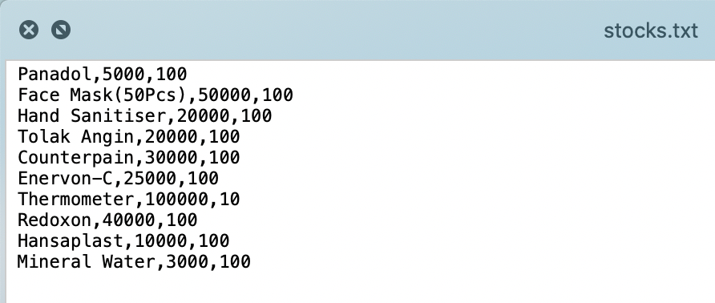
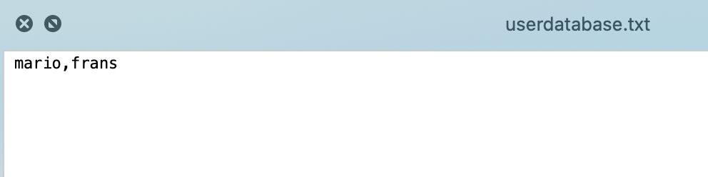
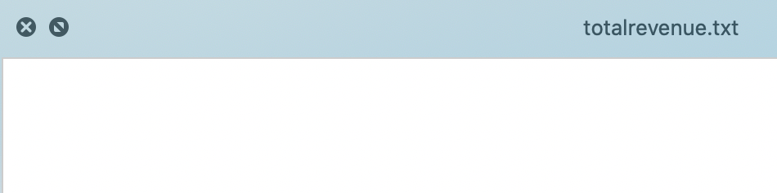
The program
Build using X-code Programming Language
3 ‘.txt’ files to be read & used by the program (pharmacy stocks, user database, and the revenue generated)

Slide 11
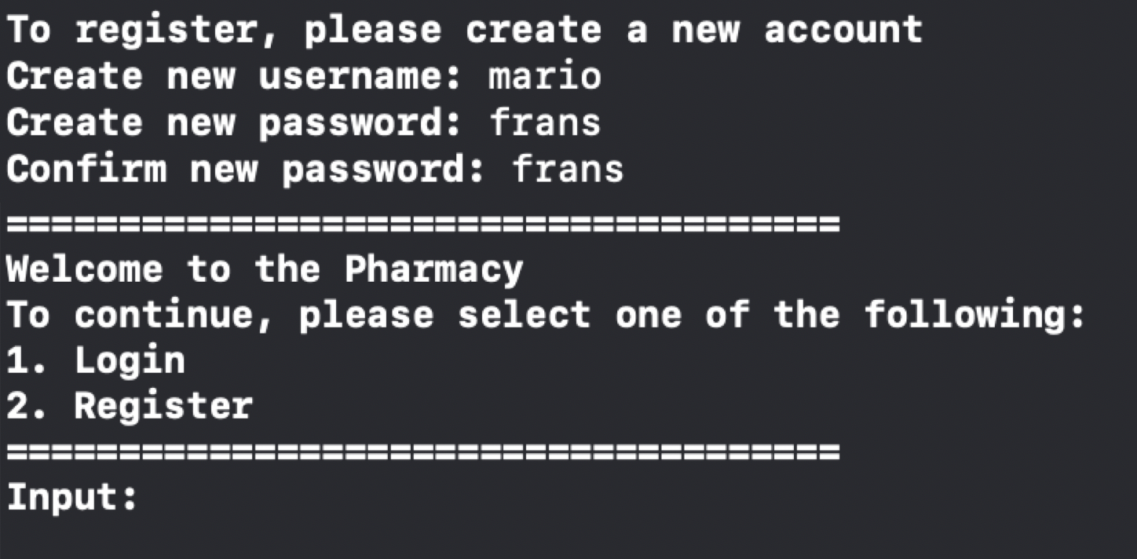
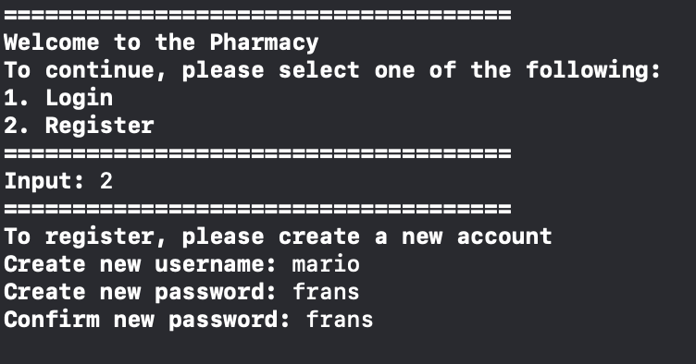
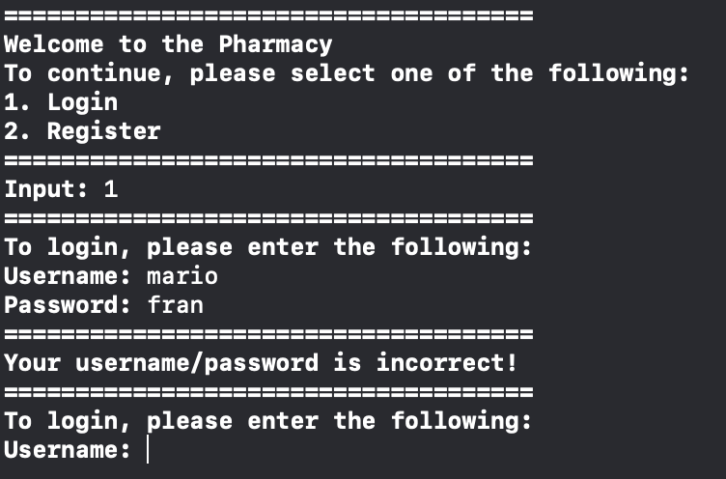
Login as customer

Slide 12
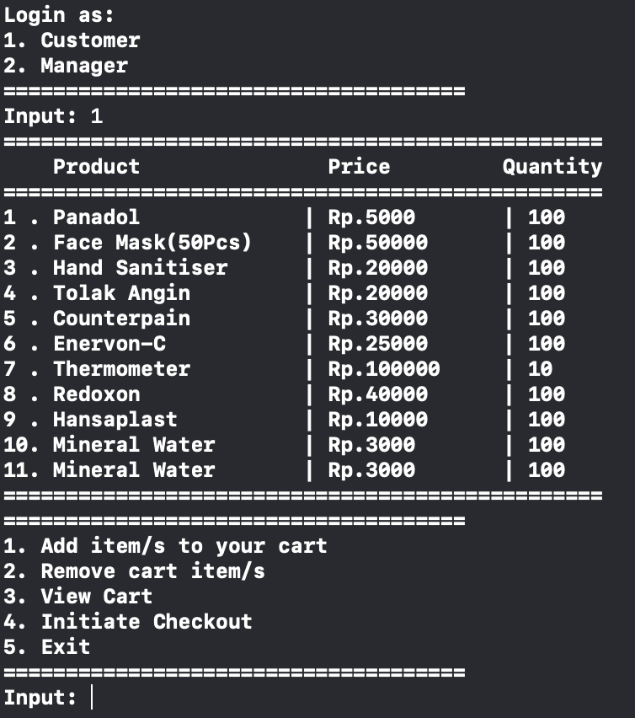
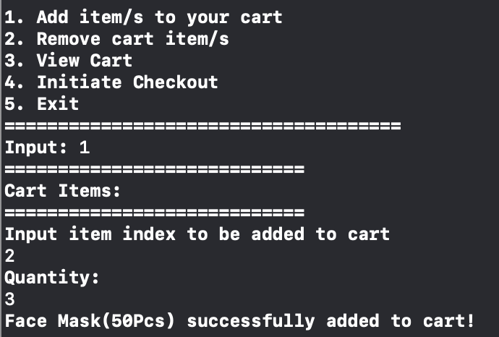
Items list & add to cart

Slide 13
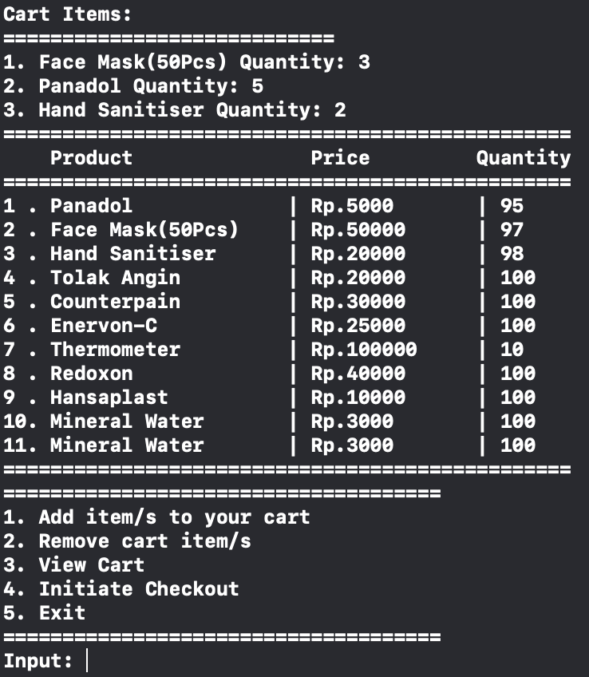
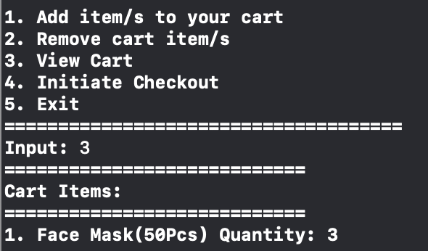
View cart

Slide 14
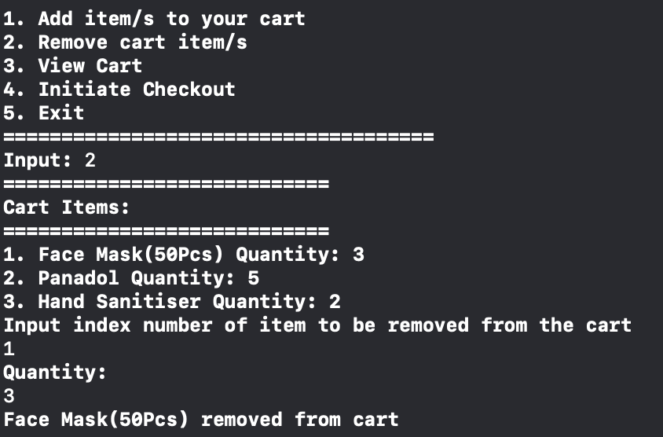
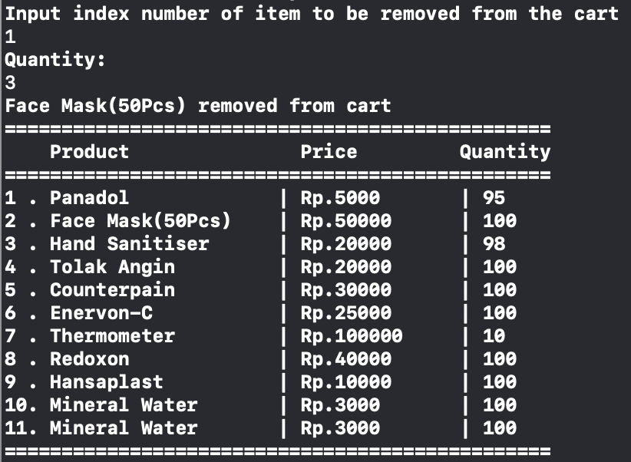
Removing item from cart

Slide 15
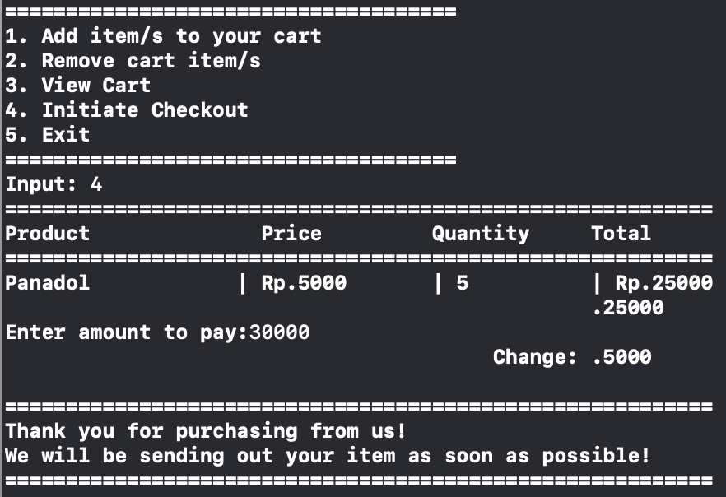
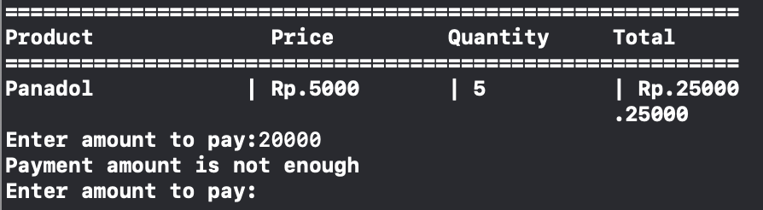
Checkout & payment

Slide 16
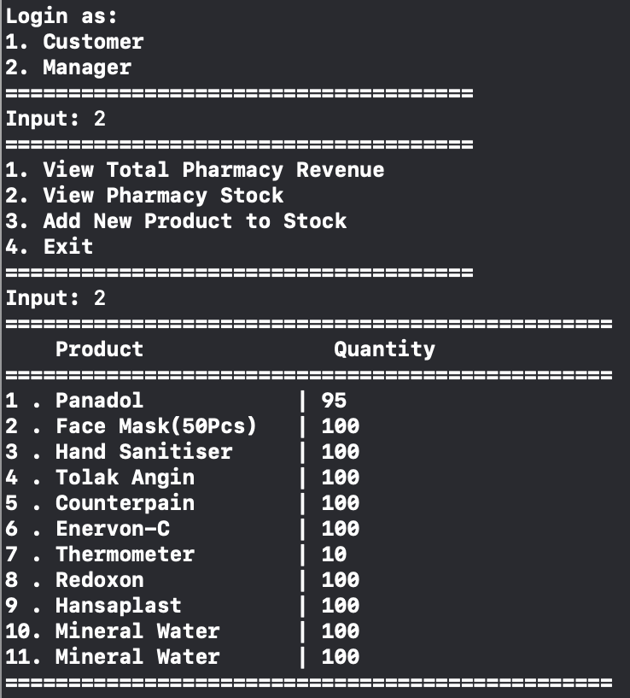
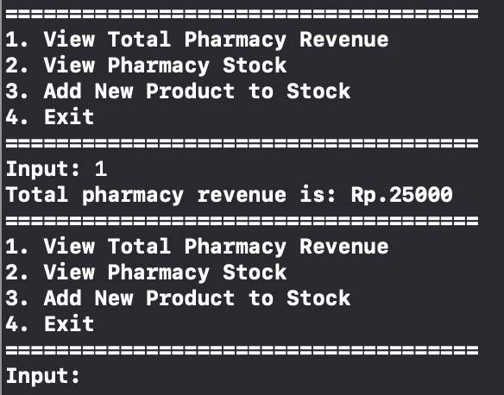
Login as a pharmacy manager Check revenue/sales

Slide 17
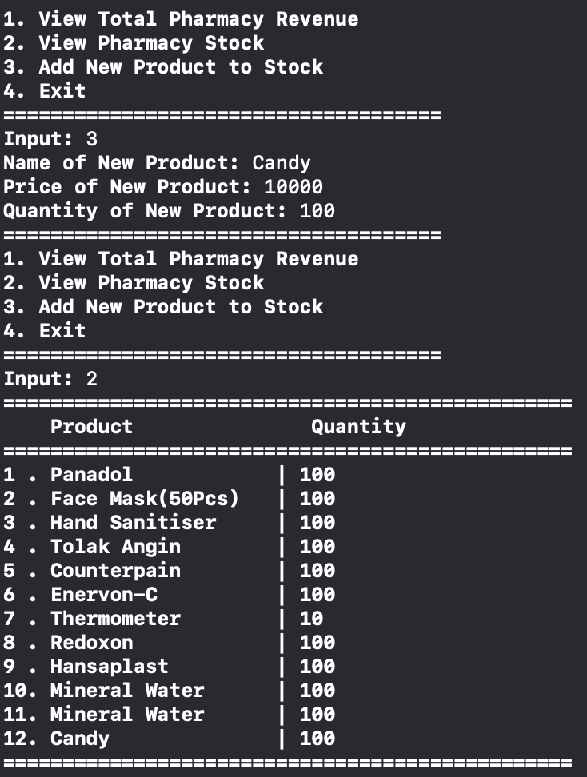
Add new item & stock

Slide 18
WorkPlan & output
Date | Daily Activities
24-25/4/2020 | Think of ideas for the project (Online Pharmacy System)
26-28/4/2020 | Create project proposal to be submitted on 30/4/2020
30/4/2020 | Proposal submission
1-3/5/2020 | Create logic (UML diagrams) for variables & methods to be implemented in the program
4/5/2020 | Progress report 1
5-10/5/2020 | Start coding & implementing the logic created on C++
11/5/2020 | Progress report 2
12-31/5/2020 | Continue coding, alpha testing, beta testing on random people (to make sure the program is user friendly enough that people can understand)
1-5/6/2020 | Fix bugs, and make comments so programmers can easily understand & make demo video
6-16/6/20 | Final evaluation
18/6/2020 | Final Submission & Presentation

Slide 19
conclusion
It is entirely possible to make an online pharmacy system using Vector Standard Template Library
So people can buy medicines online with ease without leaving their homes and risk themselves being infected, and moreover spreading the disease to their relatives when they get home

Slide 20
Project Links
GitHub: https://github.com/mariofrans/S2_Project_CPP_Pharmacy
Video: https://1drv.ms/u/s!AjvcnoBWp9nS3yOKi27Dij16KGAG?e=QwQCyS
Blog: https://fransmario.zyrosite.com/cpp-projects

Slide 21
Thank you

